Slide 1
Combating Illegal Dumping In Doña Ana County ********** Creating the Illegal Dumping Partnership
Patrick Peck
Director, SCSWA
October 2018

Slide 2
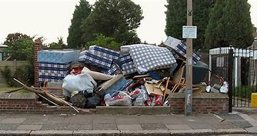
How It All Began
The Illegal Dumping Partnership (IDP) was created in 2011
It started with a simple phone call between Bureau of Land Management & South Central Solid Waste Authority
Doña Ana County was included in the first meeting
The founding members are
Bureau of Land Management (BLM)
South Central Solid Waste Authority (SCSWA)
Doña Ana County (DAC)
In the beginning, BLM had funding to hire students over the summer to pick up trash.
They were looking for partners to help haul and dispose of the collected trash.
The 3 partners met and decided to pool their resources and develop an anti-illegal dumping campaign.

Slide 3
Resources
Each member was able to pledge resources
BLM
Labor, Funding, Enforcement
DAC
Codes, GIS Mapping, Community Groups, Political Support
SCSWA
Discounted Tipping Fees, Hauling, Equipment, Public Relations

Slide 4
The Original Plan
Identify areas in the County that had illegal dumping
Define a Targeted Area and Create Enforcement Zones
Provide
Seasonal Labor to Clean Up the Area
Education and Public Relations in Targeted Community
Increase Patrols by Law Enforcement and Codes Officers
Publicize our success and gain additional support from communities and other agencies
The Untrash Our Desert Summit was first held in the Fall of 2011
Largest illegal dumping meeting ever held in the State

Slide 5
Additional Support
In 2012, we found three HHS community surveys that identified solid waste management and or trash to be a top 5 concern of residents in Doña Ana County
Utilized these surveys to gain political support
Began to develop a community-based program to address concerns
A.C.E.S. ( Hybrid of an Animal Control program)
Codes Officers go into communities to access code violations
Go door to door
Work with local community leaders to set up community clean up 2 weeks later
SCSWA brings in roll-offs and sets up in community
Codes goes back in one month and issue violations to those who don’t comply
Codes has an ACES Calendar and it has clean ups every month of the year.

Slide 6
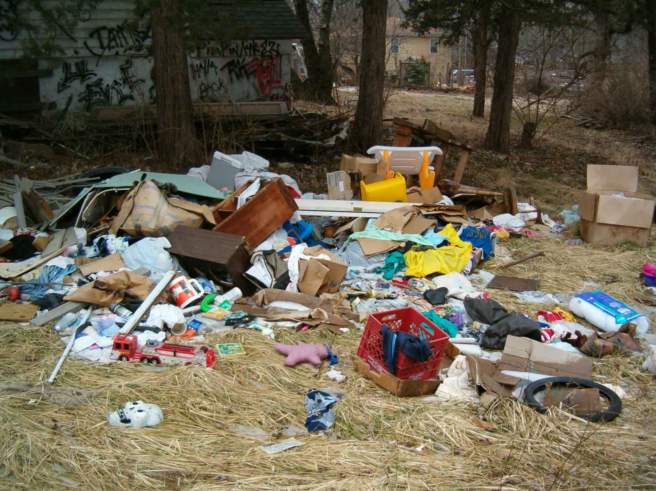
Published Results
Collecting the data and presentations are key to maintaining funding This report made it all the way to Washington D.C

Slide 7
Getting the Work Done
Work Crews
don’t just talk about it do it
Volunteers
Labor is your biggest obstacle
Policy
SCSWA will wave tipping fees for any volunteer group
Recognition
Make sure to reward that hard work with local and state recognition

Slide 8
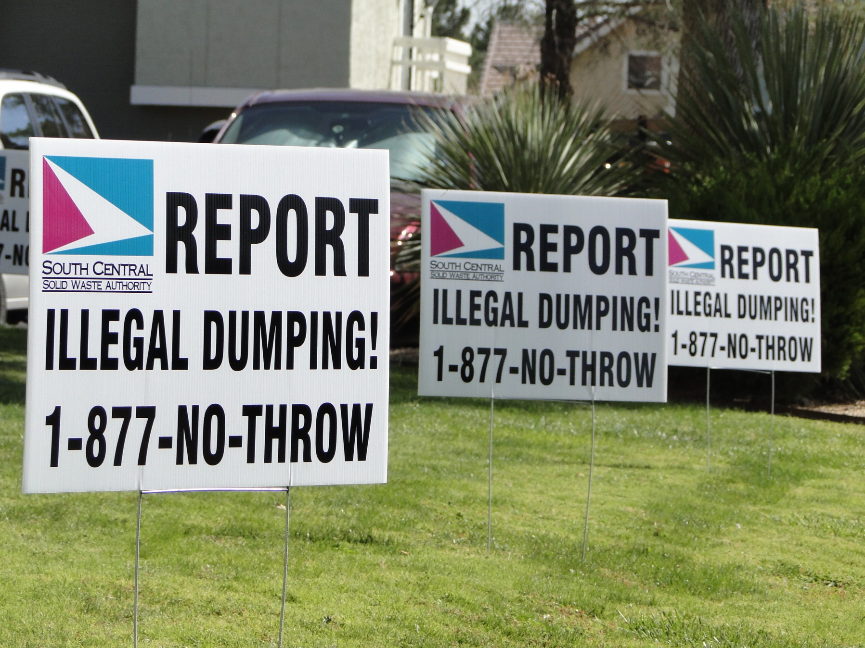
Getting the Word Out

Slide 9
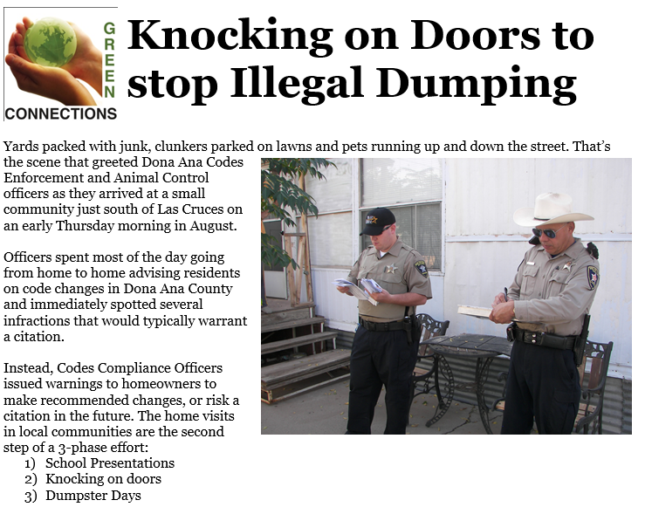
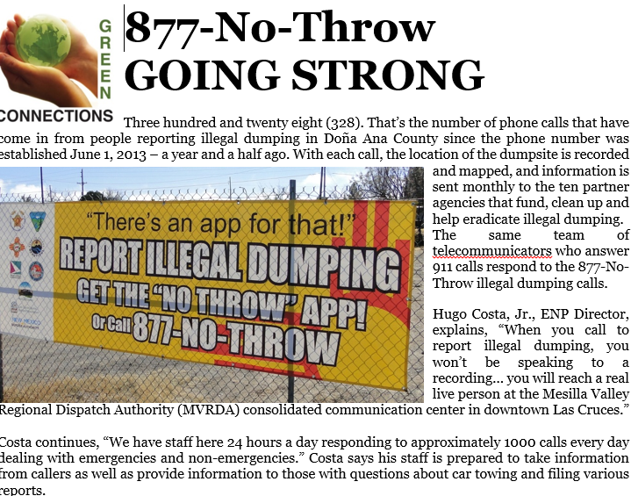
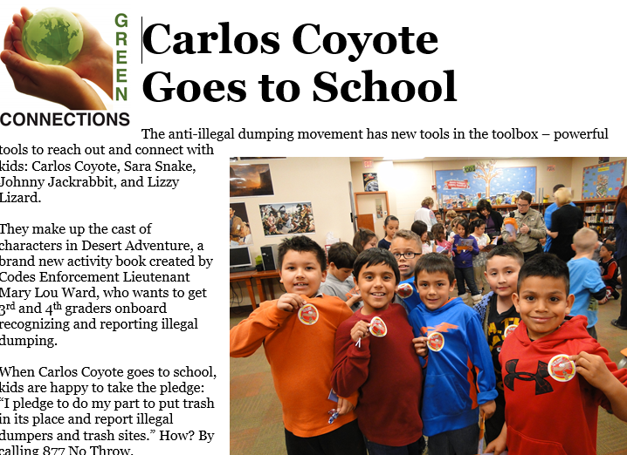
Newspaper articles 60 Articles – 7 years

Slide 10
Mentor Other Communities
Illegal Dumping is a State Wide Issue
8 years on State RAID grant review committee
Sharing of resources and ideas only makes the group strong and make illegal dumping harder
Identify resources and Partners in your community to build a state wide illegal dumping coalition

Slide 11
Contact Information
Patrick Peck Director, South Central Solid Waste Authority 575 528-3800 ppeck@las-cruces.org
Website: www.scswa.net
Facebook: @theSCSWA
Instagram: @SCSWARC

